Slide 1
Become a regexpert
Coffee and Coding 13/03/19
Megan Stodel

Slide 2
Session overview
What are regular expressions?
Why you should use them
Why you shouldn’t use them
The basics
R and regex
Regexercises

Slide 3
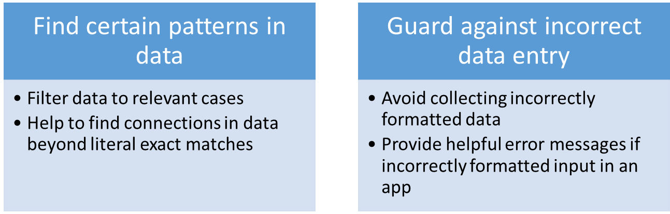
Regular expressions
AKA regex, regexp
A way to describe patterns in strings of text
Numerous applications…

Slide 4
The problems with regex
Some people, when
confronted with a problem, think
“I know, I’ll use regular
expressions.” Now they have
two problems.
- Jamie Zawinski

Slide 5
A regex to check the validity of email addresses
(?:(?:\r\n)?[ \t])*(?:(?:(?:[^()<>@,;:\\".\[\] \000-\031]+(?:(?:(?:\r\n)?[ \t] )+|\Z|(?=[\["()<>@,;:\\".\[\]]))|"(?:[^\"\r\\]|\\.|(?:(?:\r\n)?[ \t]))*"(?:(?: \r\n)?[ \t])*)(?:\.(?:(?:\r\n)?[ \t])*(?:[^()<>@,;:\\".\[\] \000-\031]+(?:(?:( ?:\r\n)?[ \t])+|\Z|(?=[\["()<>@,;:\\".\[\]]))|"(?:[^\"\r\\]|\\.|(?:(?:\r\n)?[ \t]))*"(?:(?:\r\n)?[ \t])*))*@(?:(?:\r\n)?[ \t])*(?:[^()<>@,;:\\".\[\] \000-\0 31]+(?:(?:(?:\r\n)?[ \t])+|\Z|(?=[\["()<>@,;:\\".\[\]]))|\[([^\[\]\r\\]|\\.)*\ ](?:(?:\r\n)?[ \t])*)(?:\.(?:(?:\r\n)?[ \t])*(?:[^()<>@,;:\\".\[\] \000-\031]+ (?:(?:(?:\r\n)?[ \t])+|\Z|(?=[\["()<>@,;:\\".\[\]]))|\[([^\[\]\r\\]|\\.)*\](?: (?:\r\n)?[ \t])*))*|(?:[^()<>@,;:\\".\[\] \000-\031]+(?:(?:(?:\r\n)?[ \t])+|\Z |(?=[\["()<>@,;:\\".\[\]]))|"(?:[^\"\r\\]|\\.|(?:(?:\r\n)?[ \t]))*"(?:(?:\r\n) ?[ \t])*)*\<(?:(?:\r\n)?[ \t])*(?:@(?:[^()<>@,;:\\".\[\] \000-\031]+(?:(?:(?:\ r\n)?[ \t])+|\Z|(?=[\["()<>@,;:\\".\[\]]))|\[([^\[\]\r\\]|\\.)*\](?:(?:\r\n)?[ \t])*)(?:\.(?:(?:\r\n)?[ \t])*(?:[^()<>@,;:\\".\[\] \000-\031]+(?:(?:(?:\r\n) ?[ \t])+|\Z|(?=[\["()<>@,;:\\".\[\]]))|\[([^\[\]\r\\]|\\.)*\](?:(?:\r\n)?[ \t] )*))*(?:,@(?:(?:\r\n)?[ \t])*(?:[^()<>@,;:\\".\[\] \000-\031]+(?:(?:(?:\r\n)?[ \t])+|\Z|(?=[\["()<>@,;:\\".\[\]]))|\[([^\[\]\r\\]|\\.)*\](?:(?:\r\n)?[ \t])* )(?:\.(?:(?:\r\n)?[ \t])*(?:[^()<>@,;:\\".\[\] \000-\031]+(?:(?:(?:\r\n)?[ \t] )+|\Z|(?=[\["()<>@,;:\\".\[\]]))|\[([^\[\]\r\\]|\\.)*\](?:(?:\r\n)?[ \t])*))*) *:(?:(?:\r\n)?[ \t])*)?(?:[^()<>@,;:\\".\[\] \000-\031]+(?:(?:(?:\r\n)?[ \t])+ |\Z|(?=[\["()<>@,;:\\".\[\]]))|"(?:[^\"\r\\]|\\.|(?:(?:\r\n)?[ \t]))*"(?:(?:\r \n)?[ \t])*)(?:\.(?:(?:\r\n)?[ \t])*(?:[^()<>@,;:\\".\[\] \000-\031]+(?:(?:(?: \r\n)?[ \t])+|\Z|(?=[\["()<>@,;:\\".\[\]]))|"(?:[^\"\r\\]|\\.|(?:(?:\r\n)?[ \t ]))*"(?:(?:\r\n)?[ \t])*))*@(?:(?:\r\n)?[ \t])*(?:[^()<>@,;:\\".\[\] \000-\031 ]+(?:(?:(?:\r\n)?[ \t])+|\Z|(?=[\["()<>@,;:\\".\[\]]))|\[([^\[\]\r\\]|\\.)*\]( ?:(?:\r\n)?[ \t])*)(?:\.(?:(?:\r\n)?[ \t])*(?:[^()<>@,;:\\".\[\] \000-\031]+(? :(?:(?:\r\n)?[ \t])+|\Z|(?=[\["()<>@,;:\\".\[\]]))|\[([^\[\]\r\\]|\\.)*\](?:(? :\r\n)?[ \t])*))*\>(?:(?:\r\n)?[ \t])*)|(?:[^()<>@,;:\\".\[\] \000-\031]+(?:(? :(?:\r\n)?[ \t])+|\Z|(?=[\["()<>@,;:\\".\[\]]))|"(?:[^\"\r\\]|\\.|(?:(?:\r\n)? [ \t]))*"(?:(?:\r\n)?[ \t])*)*:(?:(?:\r\n)?[ \t])*(?:(?:(?:[^()<>@,;:\\".\[\] \000-\031]+(?:(?:(?:\r\n)?[ \t])+|\Z|(?=[\["()<>@,;:\\".\[\]]))|"(?:[^\"\r\\]| \\.|(?:(?:\r\n)?[ \t]))*"(?:(?:\r\n)?[ \t])*)(?:\.(?:(?:\r\n)?[ \t])*(?:[^()<> @,;:\\".\[\] \000-\031]+(?:(?:(?:\r\n)?[ \t])+|\Z|(?=[\["()<>@,;:\\".\[\]]))|" (?:[^\"\r\\]|\\.|(?:(?:\r\n)?[ \t]))*"(?:(?:\r\n)?[ \t])*))*@(?:(?:\r\n)?[ \t] )*(?:[^()<>@,;:\\".\[\] \000-\031]+(?:(?:(?:\r\n)?[ \t])+|\Z|(?=[\["()<>@,;:\\ ".\[\]]))|\[([^\[\]\r\\]|\\.)*\](?:(?:\r\n)?[ \t])*)(?:\.(?:(?:\r\n)?[ \t])*(? :[^()<>@,;:\\".\[\] \000-\031]+(?:(?:(?:\r\n)?[ \t])+|\Z|(?=[\["()<>@,;:\\".\[ \]]))|\[([^\[\]\r\\]|\\.)*\](?:(?:\r\n)?[ \t])*))*|(?:[^()<>@,;:\\".\[\] \000- \031]+(?:(?:(?:\r\n)?[ \t])+|\Z|(?=[\["()<>@,;:\\".\[\]]))|"(?:[^\"\r\\]|\\.|( ?:(?:\r\n)?[ \t]))*"(?:(?:\r\n)?[ \t])*)*\<(?:(?:\r\n)?[ \t])*(?:@(?:[^()<>@,; :\\".\[\] \000-\031]+(?:(?:(?:\r\n)?[ \t])+|\Z|(?=[\["()<>@,;:\\".\[\]]))|\[([ ^\[\]\r\\]|\\.)*\](?:(?:\r\n)?[ \t])*)(?:\.(?:(?:\r\n)?[ \t])*(?:[^()<>@,;:\\" .\[\] \000-\031]+(?:(?:(?:\r\n)?[ \t])+|\Z|(?=[\["()<>@,;:\\".\[\]]))|\[([^\[\ ]\r\\]|\\.)*\](?:(?:\r\n)?[ \t])*))*(?:,@(?:(?:\r\n)?[ \t])*(?:[^()<>@,;:\\".\ [\] \000-\031]+(?:(?:(?:\r\n)?[ \t])+|\Z|(?=[\["()<>@,;:\\".\[\]]))|\[([^\[\]\ r\\]|\\.)*\](?:(?:\r\n)?[ \t])*)(?:\.(?:(?:\r\n)?[ \t])*(?:[^()<>@,;:\\".\[\] \000-\031]+(?:(?:(?:\r\n)?[ \t])+|\Z|(?=[\["()<>@,;:\\".\[\]]))|\[([^\[\]\r\\] |\\.)*\](?:(?:\r\n)?[ \t])*))*)*:(?:(?:\r\n)?[ \t])*)?(?:[^()<>@,;:\\".\[\] \0 00-\031]+(?:(?:(?:\r\n)?[ \t])+|\Z|(?=[\["()<>@,;:\\".\[\]]))|"(?:[^\"\r\\]|\\ .|(?:(?:\r\n)?[ \t]))*"(?:(?:\r\n)?[ \t])*)(?:\.(?:(?:\r\n)?[ \t])*(?:[^()<>@, ;:\\".\[\] \000-\031]+(?:(?:(?:\r\n)?[ \t])+|\Z|(?=[\["()<>@,;:\\".\[\]]))|"(? :[^\"\r\\]|\\.|(?:(?:\r\n)?[ \t]))*"(?:(?:\r\n)?[ \t])*))*@(?:(?:\r\n)?[ \t])* (?:[^()<>@,;:\\".\[\] \000-\031]+(?:(?:(?:\r\n)?[ \t])+|\Z|(?=[\["()<>@,;:\\". \[\]]))|\[([^\[\]\r\\]|\\.)*\](?:(?:\r\n)?[ \t])*)(?:\.(?:(?:\r\n)?[ \t])*(?:[ ^()<>@,;:\\".\[\] \000-\031]+(?:(?:(?:\r\n)?[ \t])+|\Z|(?=[\["()<>@,;:\\".\[\] ]))|\[([^\[\]\r\\]|\\.)*\](?:(?:\r\n)?[ \t])*))*\>(?:(?:\r\n)?[ \t])*)(?:,\s*( ?:(?:[^()<>@,;:\\".\[\] \000-\031]+(?:(?:(?:\r\n)?[ \t])+|\Z|(?=[\["()<>@,;:\\ ".\[\]]))|"(?:[^\"\r\\]|\\.|(?:(?:\r\n)?[ \t]))*"(?:(?:\r\n)?[ \t])*)(?:\.(?:( ?:\r\n)?[ \t])*(?:[^()<>@,;:\\".\[\] \000-\031]+(?:(?:(?:\r\n)?[ \t])+|\Z|(?=[ \["()<>@,;:\\".\[\]]))|"(?:[^\"\r\\]|\\.|(?:(?:\r\n)?[ \t]))*"(?:(?:\r\n)?[ \t ])*))*@(?:(?:\r\n)?[ \t])*(?:[^()<>@,;:\\".\[\] \000-\031]+(?:(?:(?:\r\n)?[ \t ])+|\Z|(?=[\["()<>@,;:\\".\[\]]))|\[([^\[\]\r\\]|\\.)*\](?:(?:\r\n)?[ \t])*)(? :\.(?:(?:\r\n)?[ \t])*(?:[^()<>@,;:\\".\[\] \000-\031]+(?:(?:(?:\r\n)?[ \t])+| \Z|(?=[\["()<>@,;:\\".\[\]]))|\[([^\[\]\r\\]|\\.)*\](?:(?:\r\n)?[ \t])*))*|(?: [^()<>@,;:\\".\[\] \000-\031]+(?:(?:(?:\r\n)?[ \t])+|\Z|(?=[\["()<>@,;:\\".\[\ ]]))|"(?:[^\"\r\\]|\\.|(?:(?:\r\n)?[ \t]))*"(?:(?:\r\n)?[ \t])*)*\<(?:(?:\r\n) ?[ \t])*(?:@(?:[^()<>@,;:\\".\[\] \000-\031]+(?:(?:(?:\r\n)?[ \t])+|\Z|(?=[\[" ()<>@,;:\\".\[\]]))|\[([^\[\]\r\\]|\\.)*\](?:(?:\r\n)?[ \t])*)(?:\.(?:(?:\r\n) ?[ \t])*(?:[^()<>@,;:\\".\[\] \000-\031]+(?:(?:(?:\r\n)?[ \t])+|\Z|(?=[\["()<> @,;:\\".\[\]]))|\[([^\[\]\r\\]|\\.)*\](?:(?:\r\n)?[ \t])*))*(?:,@(?:(?:\r\n)?[ \t])*(?:[^()<>@,;:\\".\[\] \000-\031]+(?:(?:(?:\r\n)?[ \t])+|\Z|(?=[\["()<>@, ;:\\".\[\]]))|\[([^\[\]\r\\]|\\.)*\](?:(?:\r\n)?[ \t])*)(?:\.(?:(?:\r\n)?[ \t] )*(?:[^()<>@,;:\\".\[\] \000-\031]+(?:(?:(?:\r\n)?[ \t])+|\Z|(?=[\["()<>@,;:\\ ".\[\]]))|\[([^\[\]\r\\]|\\.)*\](?:(?:\r\n)?[ \t])*))*)*:(?:(?:\r\n)?[ \t])*)? (?:[^()<>@,;:\\".\[\] \000-\031]+(?:(?:(?:\r\n)?[ \t])+|\Z|(?=[\["()<>@,;:\\". \[\]]))|"(?:[^\"\r\\]|\\.|(?:(?:\r\n)?[ \t]))*"(?:(?:\r\n)?[ \t])*)(?:\.(?:(?: \r\n)?[ \t])*(?:[^()<>@,;:\\".\[\] \000-\031]+(?:(?:(?:\r\n)?[ \t])+|\Z|(?=[\[ "()<>@,;:\\".\[\]]))|"(?:[^\"\r\\]|\\.|(?:(?:\r\n)?[ \t]))*"(?:(?:\r\n)?[ \t]) *))*@(?:(?:\r\n)?[ \t])*(?:[^()<>@,;:\\".\[\] \000-\031]+(?:(?:(?:\r\n)?[ \t]) +|\Z|(?=[\["()<>@,;:\\".\[\]]))|\[([^\[\]\r\\]|\\.)*\](?:(?:\r\n)?[ \t])*)(?:\ .(?:(?:\r\n)?[ \t])*(?:[^()<>@,;:\\".\[\] \000-\031]+(?:(?:(?:\r\n)?[ \t])+|\Z |(?=[\["()<>@,;:\\".\[\]]))|\[([^\[\]\r\\]|\\.)*\](?:(?:\r\n)?[ \t])*))*\>(?:( ?:\r\n)?[ \t])*))*)?;\s*)
Notes:
Source: http://www.ex-parrot.com/~pdw/Mail-RFC822-Address.html

Slide 6
There are lots of irregularities in language and human design
Interesting reading
Falsehoods programmers believe about names
Falsehoods programmers believe about addresses
Falsehoods programmers believe about time
More!

Slide 7

The basics
Matching exact strings
“apple” will match anything with that string included.
apple
pineapple
lemon
Apple

Slide 8
The basics
Helpful shorthand for character matching
. | Matches any character | “.a” matches “pineapple”, not “apple”
\d | Matches any digit | “\d” matches “4”, not “four”
\s | Matches any whitespace | “\s” matches “pine apple”, not “pineapple”
[abc] | Matches a, b or c | “[abc]” matches “apple”, not “lemon”
[^abc] | Matches anything except a, b or c | “[^abc]” matches “lemon”, not “apple”
[a-e] | Character in range a-e | “[a-e]” matches “apple” AND “lemon”
[a-z] | Any lowercase character | “[a-z]” matches “four”, not “4”
[a-zA-Z] | Any lower or uppercase character | “[a-zA-Z]” matches “apple” AND “Apple”

Slide 9
The basics
Anchors
^ | Start of string | “^a” matches “apple”, not “pineapple”
$ | End of string | “a$” matches “banana”, not “apple”
\b | Word boundary | “\bapple” matches “apple”, not “pineapple”
If you begin with power (^), you end up with money ($)
- Evan Misshula

Slide 10
The basics
Repetition
? | 0 or 1
+ | 1 or more
* | 0 or more
{n} | Exactly n times
{n,} | n or more
{,m} | At most m
{n,m} | Between n and m times

Slide 11
Some extra points
Matches never overlap.
    For e.g., “banana” contains one instance of “ana”, not two.
You can use | to pick between one or more patterns.
    For e.g., “abc|def” will match either ‘“abc” or "def".
You can use parantheses, as you would in mathematical expressions.
    For e.g., “T(i|o)m” will match either “Tim” or “Tom”
See here for a cheat sheet for basic regular expressions in R.

Slide 12
R and regex
Escaping special characters
Sometimes you will want to match a character that has a special meaning in regex. To do that, use a backslash.
“\.”
However, backslashes are also used as escape symbols in strings in R, so you need to escape the escape symbol AND the special characters.
“\\.”
This can get particularly intense when you are trying to match a literal backslash.
“\\\\”

Slide 13
R and regex
Some useful functions
stringr::str_view()
Show you how a character vector and regular expression match.
stringr::str_which / grep()
Returns the index position of matches.
stringr::str_detect / grepl()
Return a logical vector. These also therefore allow you to count the number of matches when combined with sum(), for example.
stringr::str_extract()
Extract only the parts of a character vector that match a regex.
stringr::str_replace() / gsub()
Replace matches with another defined string.

Slide 14
Regexample
What does this describe?
^[A-Z][a-z]*$
Start of the string
One capital letter
Zero or more lower case letters
End of the string
A single word that starts with a capital letter but is otherwise lowercase (for example, proper nouns or words at the start of sentences)

Slide 15
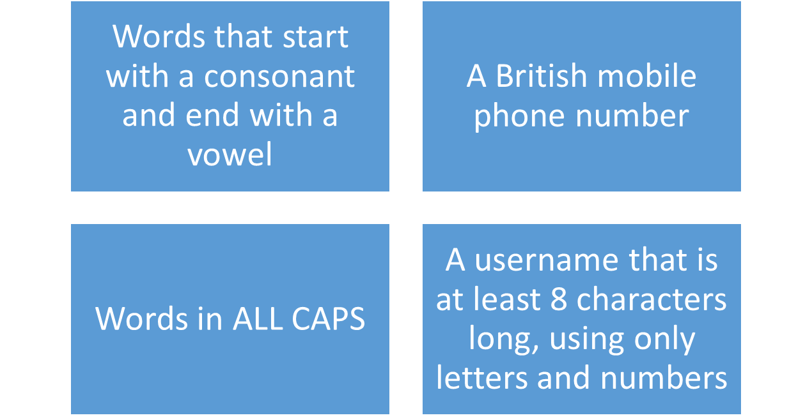
Regexercises
Create a regex for the following conditions

